Slide 1
How to Create a PowerPoint Presentation
(This is going to be awesome and informative, we promise)

Slide 2
THIS IS MY TITLE SLID
Ermagherd writing is so fun and I love playing with colors
Having inconsistent font size is cool
I like making my audience squint to read
Why not also change font types?
And definitely have COOL transitions with lots of sounds and flashiness

Slide 3
This is My Title Slide
Here is all the information I was going to put on here that I pretty much just copy-pasted from my paper in order to save time. Don’t worry, no one is ever going to read this much anyways. In fact, I’m going to use long words, and make sure I am superfluous as possible because I need to make sure I talk about EVERYTHING I meant to talk about in my paper. My topic is really cool. Like super cool. And I want to talk about it for over an hour. Too bad this presentation is short.
Isn’t public speaking awesome?
Here’s a picture of something to support something I was going to say but it looks like what I was saying took up too much space so here, have a picture of a cat. YAY CATS

Slide 4
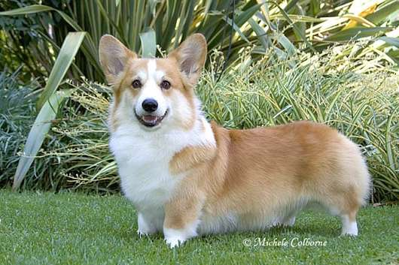
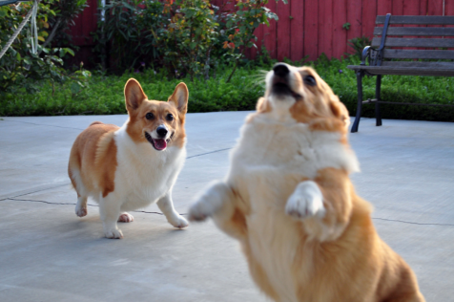
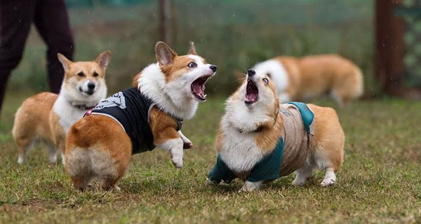
This is My Title Slide
Look at all the pictures I have to support what I am going to say
Wow there are so many pictures I can’t wait to talk about them all
Look at how beautifully colorful everything is
Hooray for sound effects

Slide 5
This is My Title Slide
I’m going to be talking about terrorism
This is going to be important
Why is my background an awkward seal meme? I dunno. Thought it would be cool.

Slide 6
Alright! Now onto the real tips
PowerPoints are important as visual aids. Of course, you have other options (like Prezi), and charts and graphs.
These are meant to enhance your presentation.

Slide 7
Tips continued
That previous slide looked a bit boring, didn’t it?
That’s because it had nothing to support it!
Here’s a picture for reference—make sure it’s something relevant to your presentation.

Slide 8
Using text to your advantage
Feel free to bold or underline or even color the things you deem important.
This draws viewers’ eyes to your terms.
But not like this. That hurts a little too much.

Slide 9
Smart Art
Smart art is available on the “insert” tab.
There are a lot of really cool options that show flow between ideas. These are helpful because they promote ideas with minimal text.

Slide 10
Smart Art

Slide 11
Smart Art

Slide 12
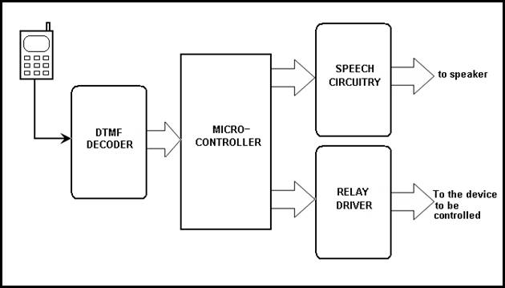
Sample Block Diagram

Slide 13
Photographs
Internet memes have surfaced within the past few years as a source of entertainment.
Typically, there is bold white font on the top and bottom of an easily recognizable picture.
We discourage the use of them for your presentations
Instead make sure you annotate any photographs that you use.

Slide 14
Condescending Wonka

Slide 15
Annotated Picture

Slide 16
How to Create Good Visual Aids
Know what you’re going to talk about
Determine the images, graphs, and formulas to use to best enhance your ideas
Use minimal text
Your pictures should be relevant and match the tone and pace of your presentation
Make sure you cite your images, graphs, formulas, either on bottom of slide or in a final slide bibliography

Slide 17
A final reminder…
Some texts work on some computers and not on others.
Beware, because this could mess up formatting, and/or put your font into alien language.
“Beware, because this could mess up formatting, and/or put your font into alien language. “

Slide 18
This is the final reminder (we promise)
Always test your presentation on the equipment you plan on using before your presentation. You do not want any surprises.
Make sure you save a copy of your visual aids elsewhere!
Email it to yourself
Save it on a USB
Ensure you have a backup because tech problems happen often.

